Slide 1
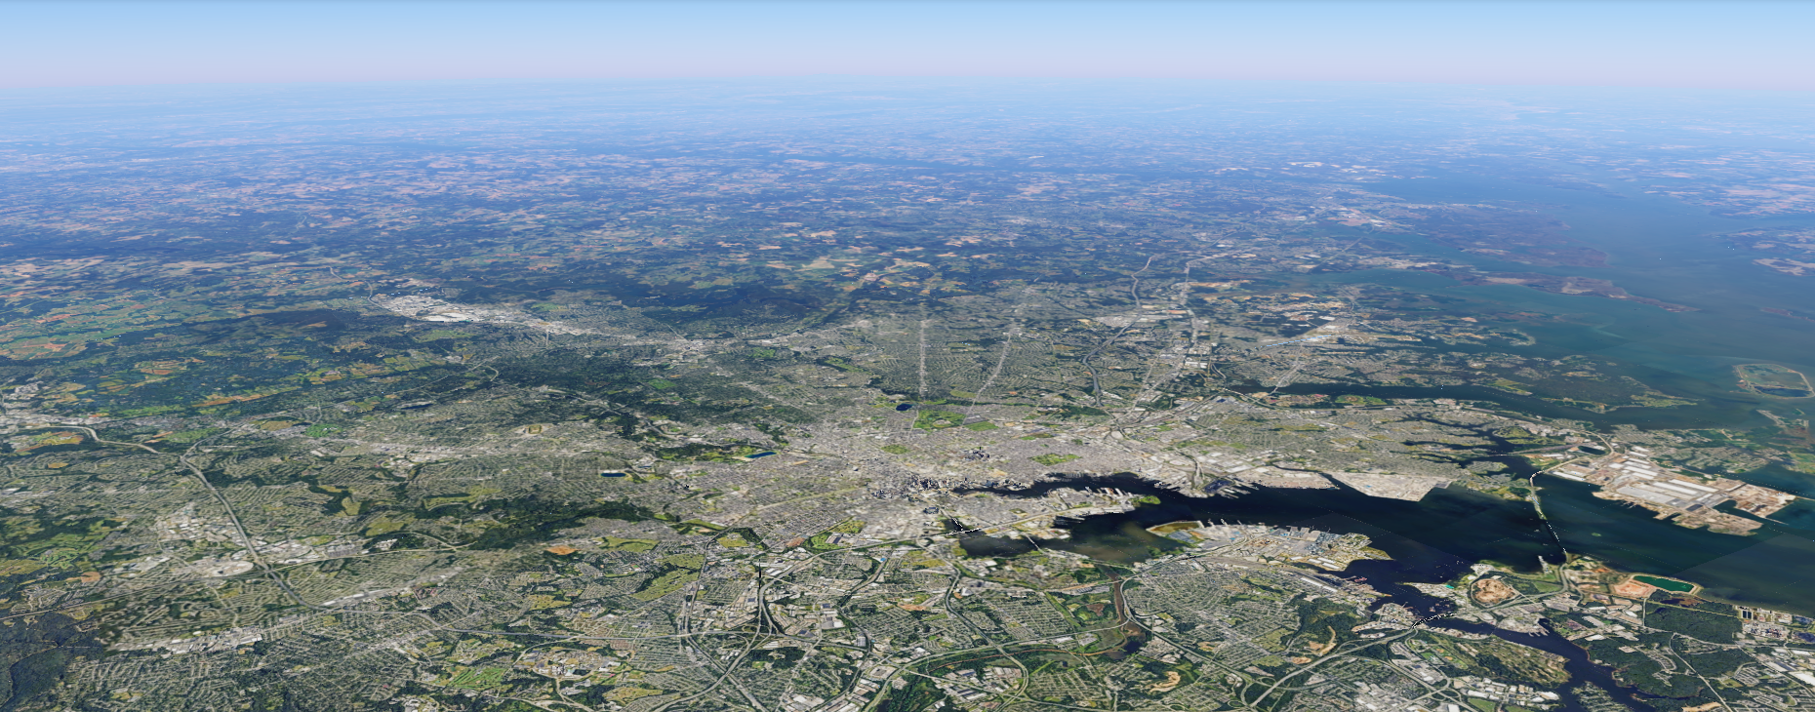



Centering equity
Manny Teodoro & David Switzer
Baltimore Regional Water Governance Model Workgroup
Meeting #3 | 20 May 2026

Slide 2
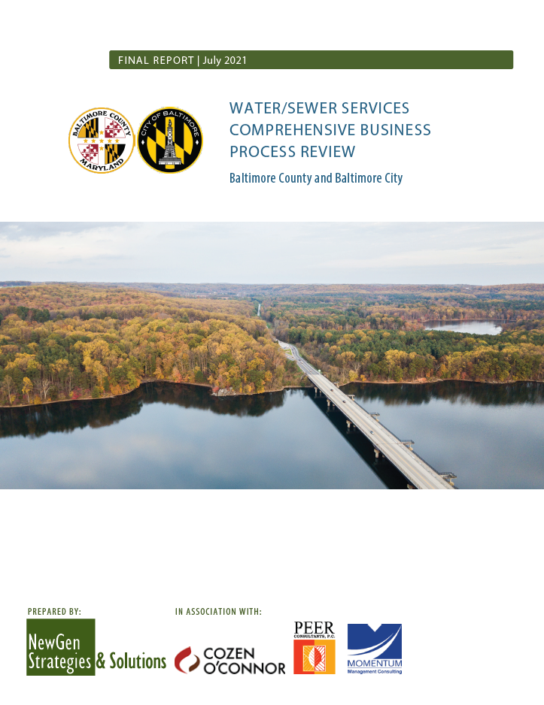
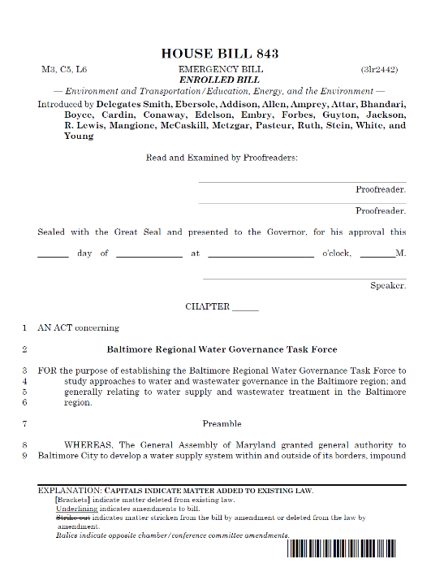
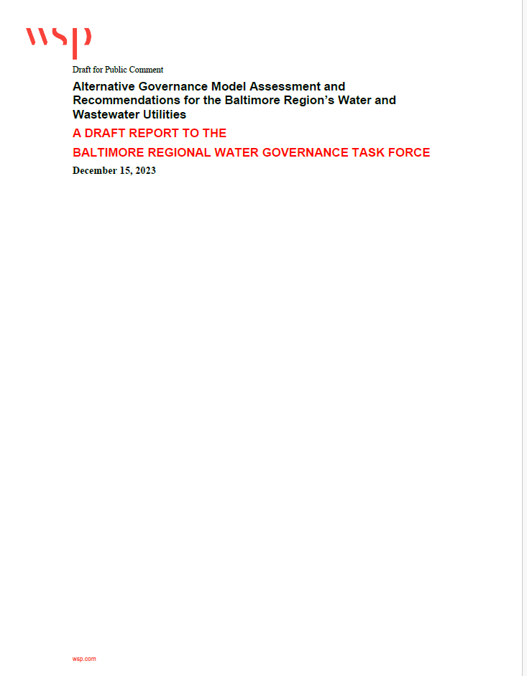
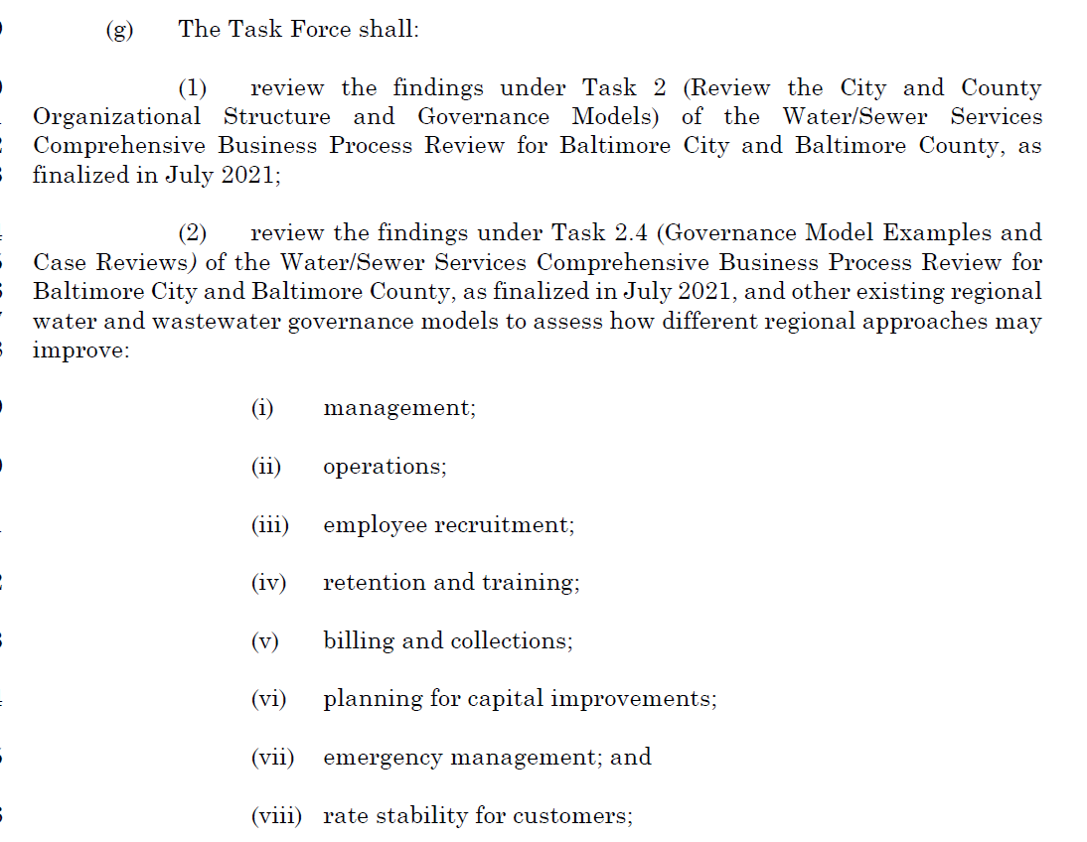
Past work

Slide 3
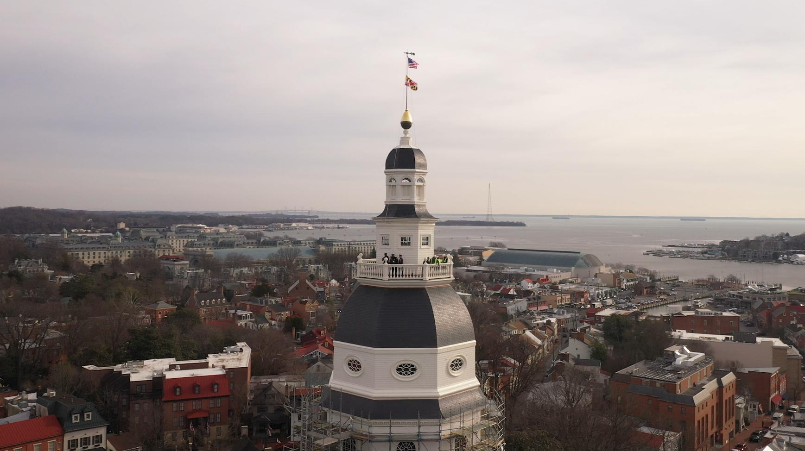
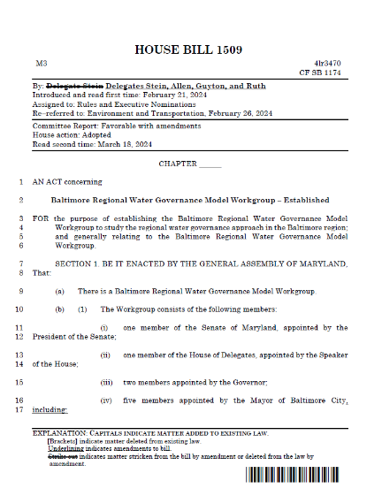
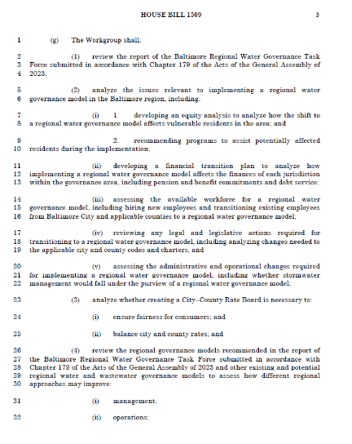
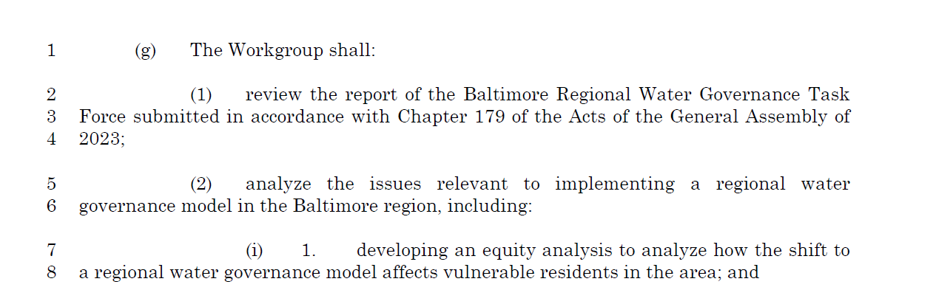


Present work

Slide 4
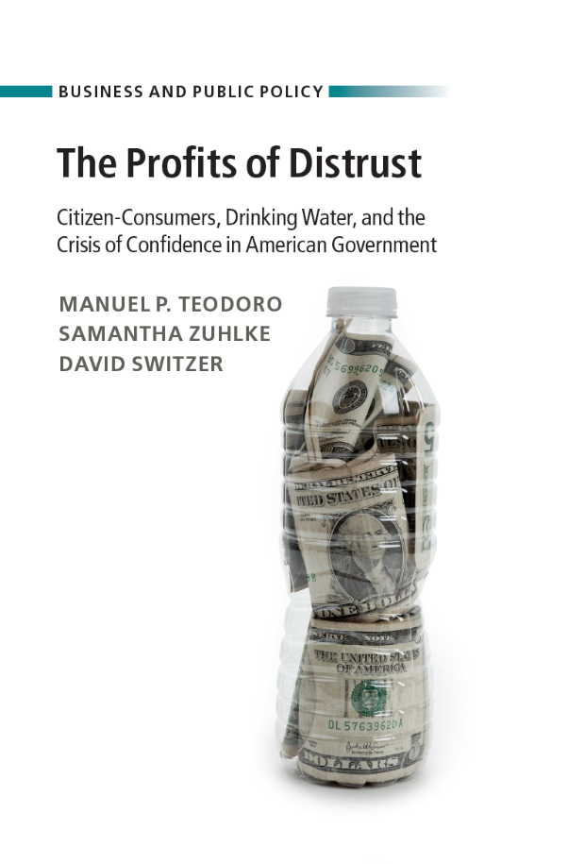
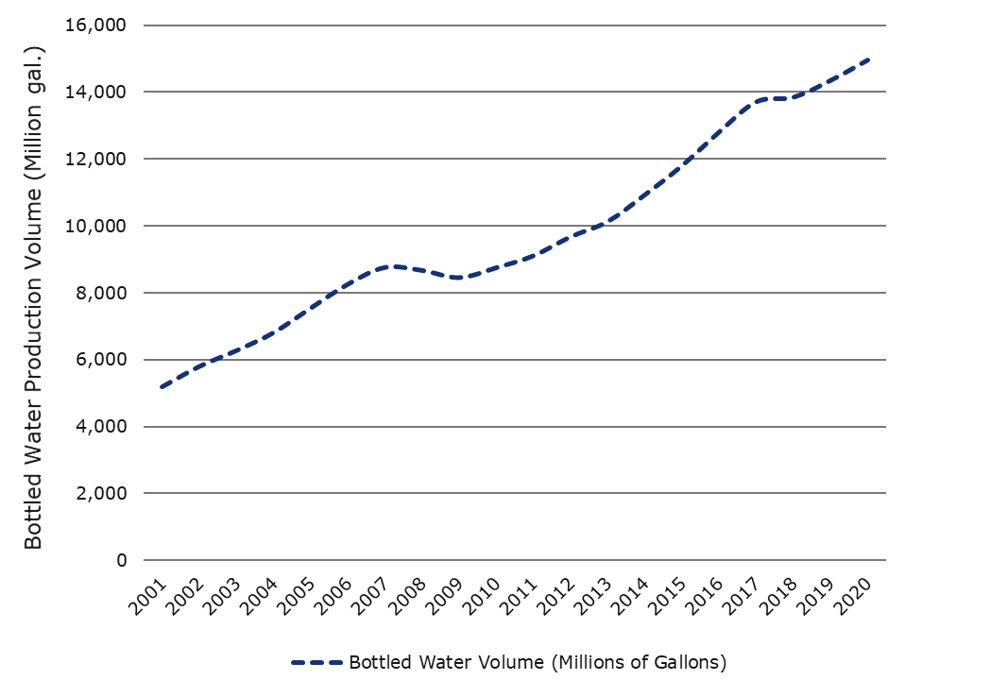
Bottled water sales volume, 2001-2020

Slide 5
Trust
Equity

Slide 6
Equity
Water and sewer services that are excellent and open for everyone.

Slide 7
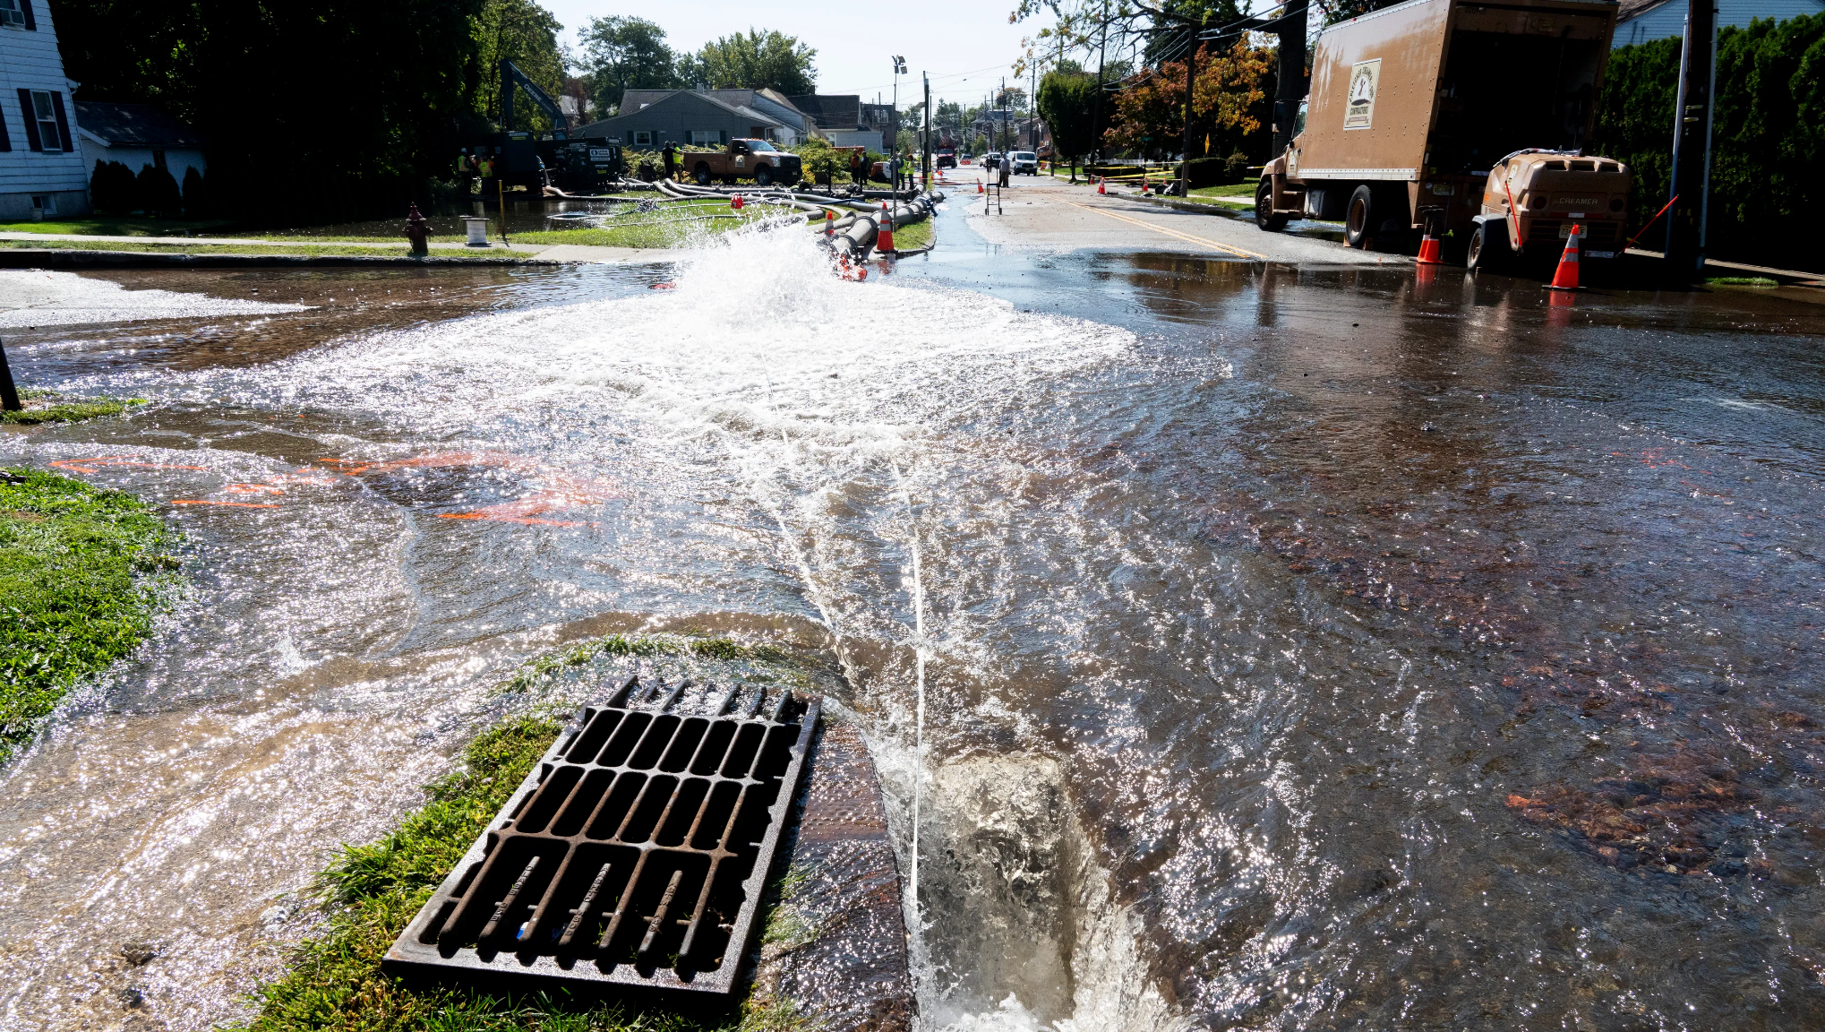

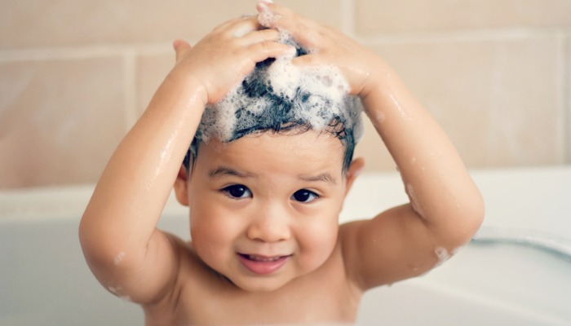
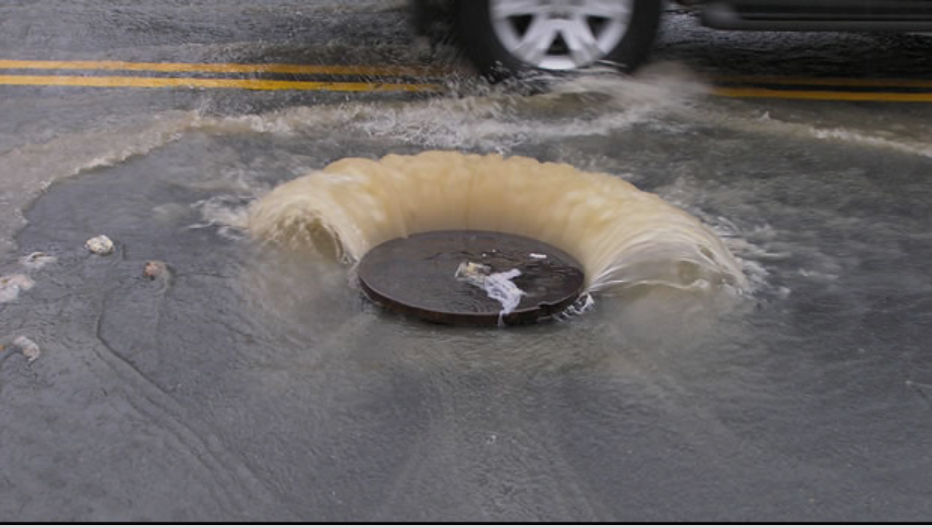
Excellence: quality

Slide 8
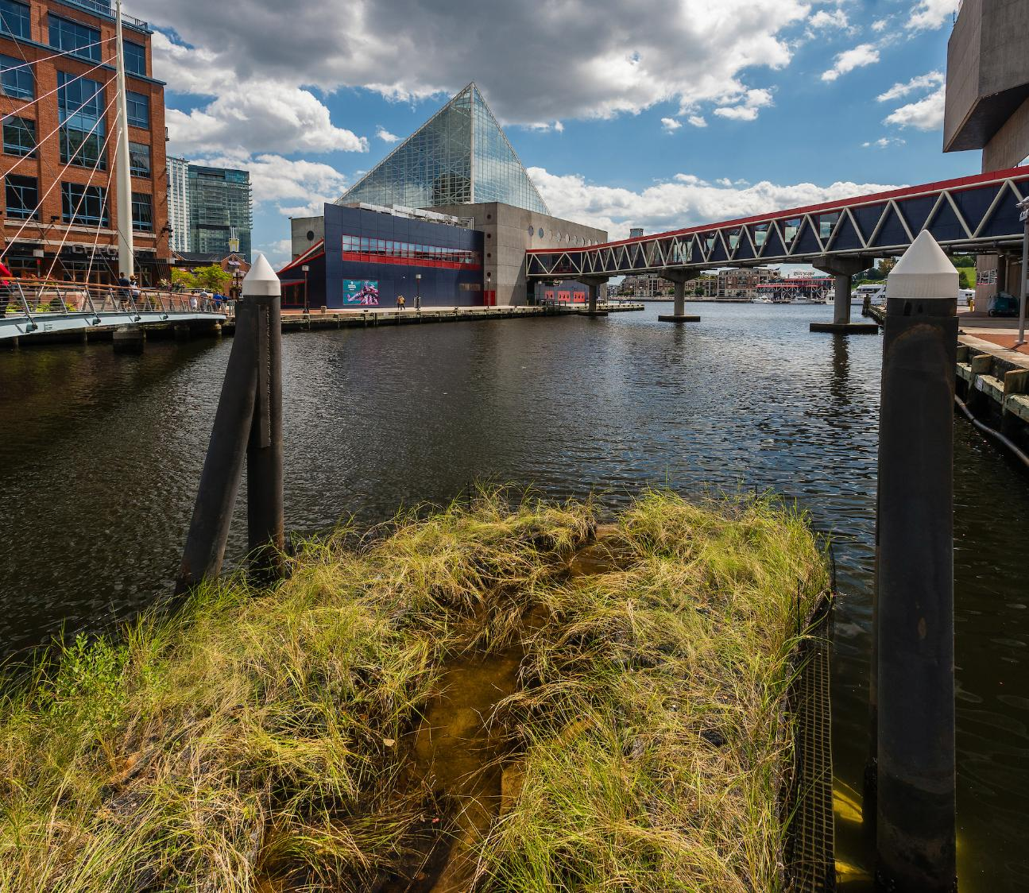
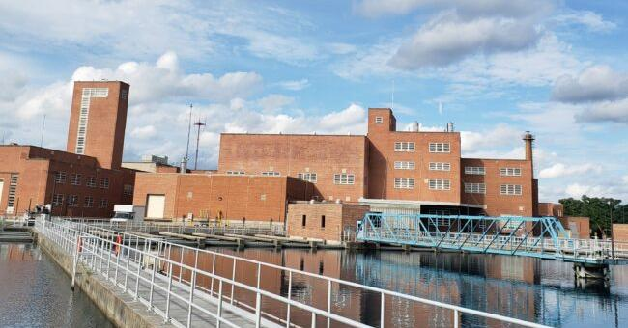
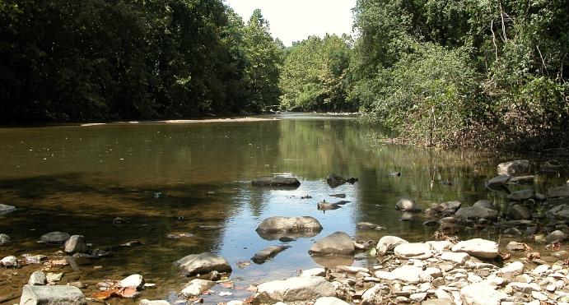
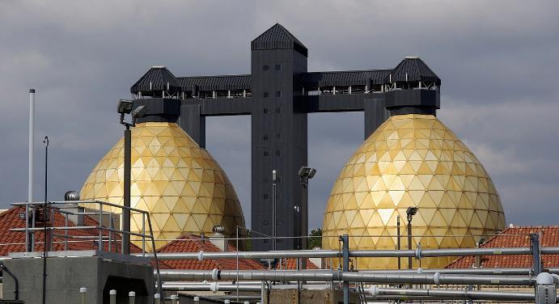
Excellence: sustainability

Slide 9
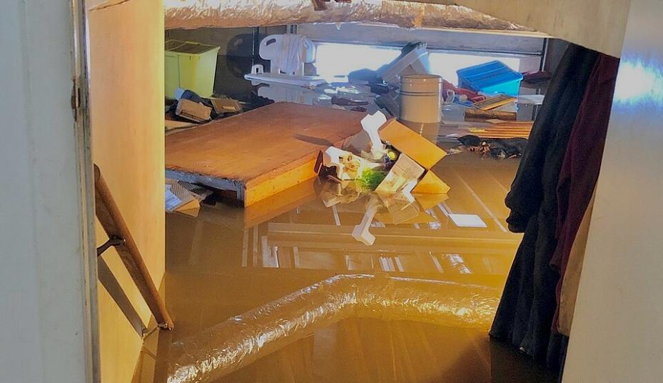
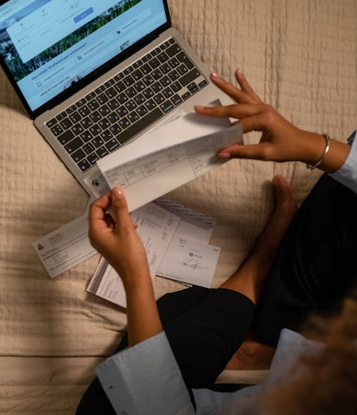
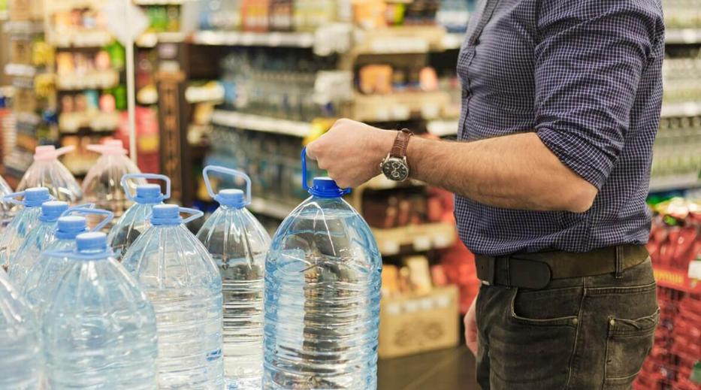
Excellence: Affordability

Slide 10
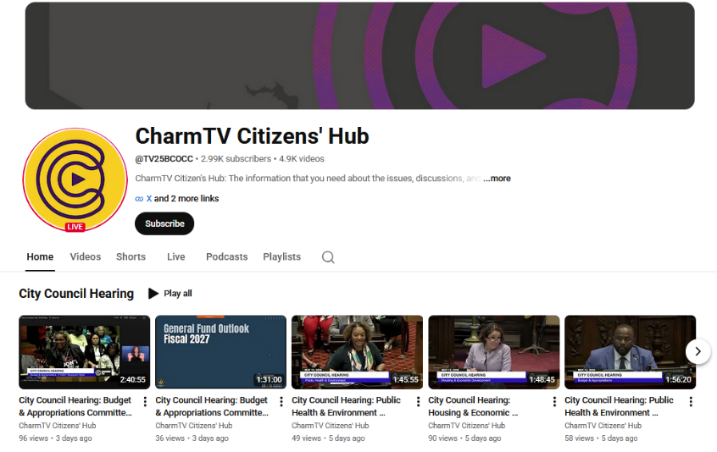
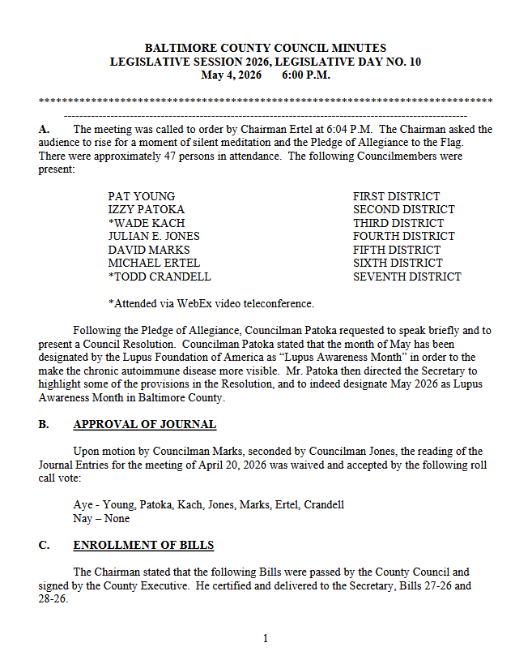
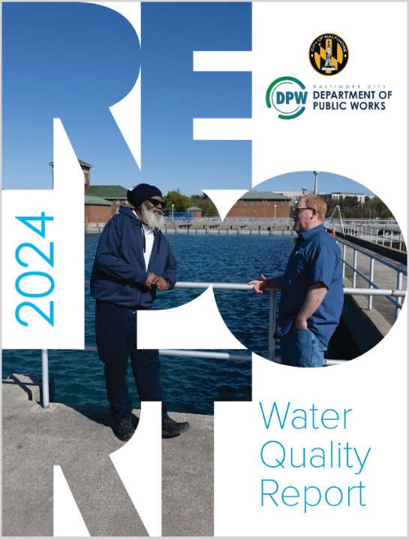
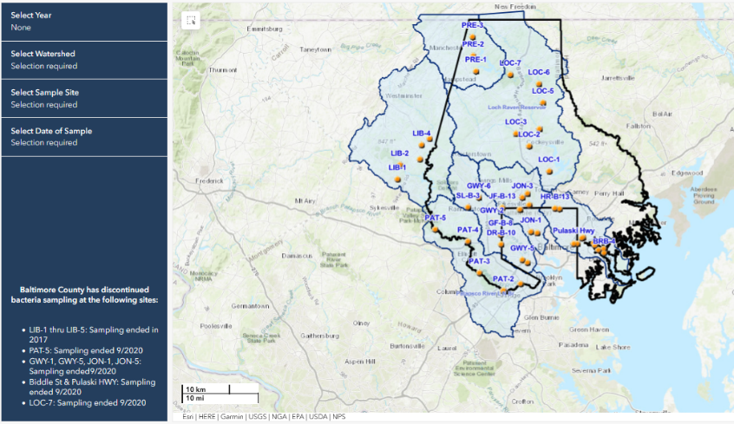
Openness: transparency
Notes:
Transparency

Slide 11
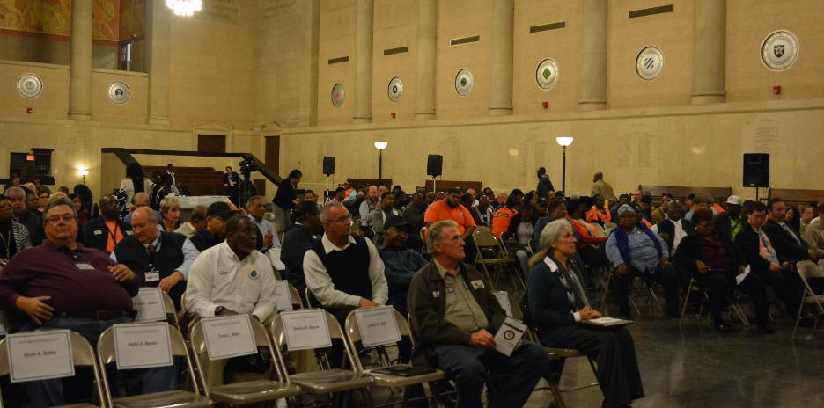
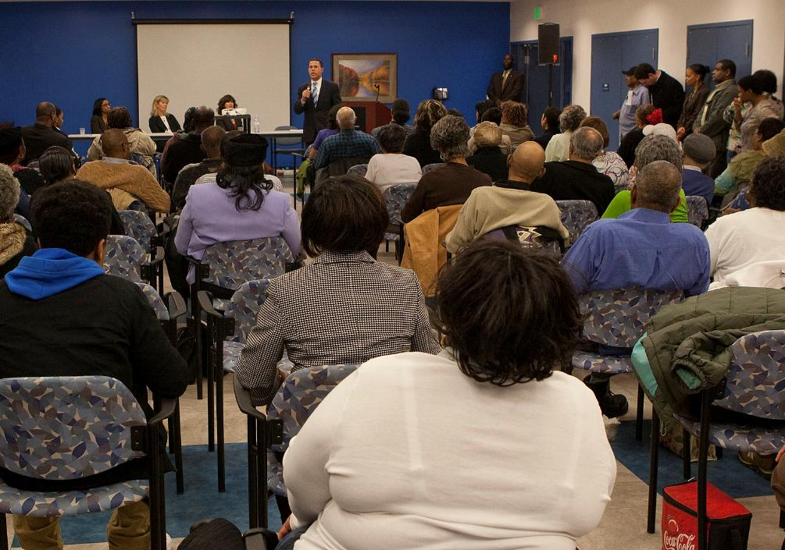
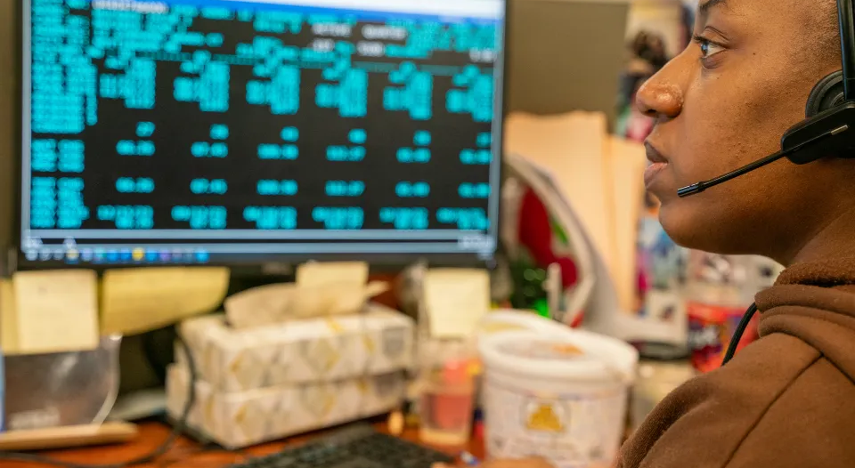
Openness: engagement
Notes:
Engagement: Old school

Slide 12
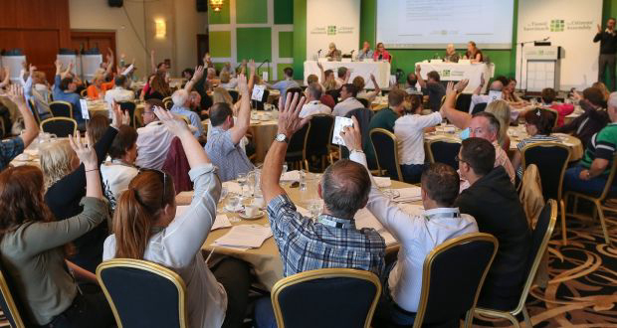

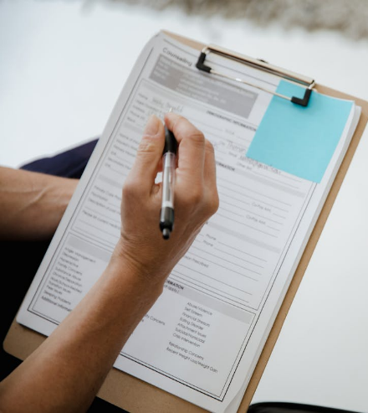
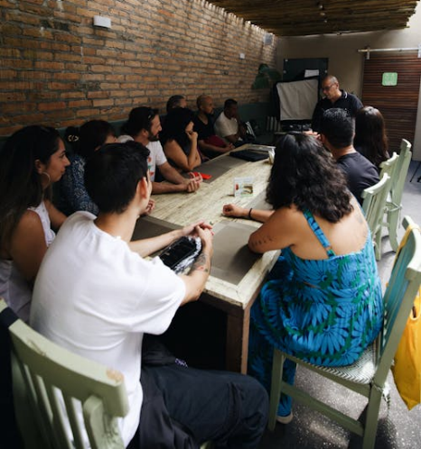
Openness: active engagement
Notes:
Engagement: New School

Slide 13
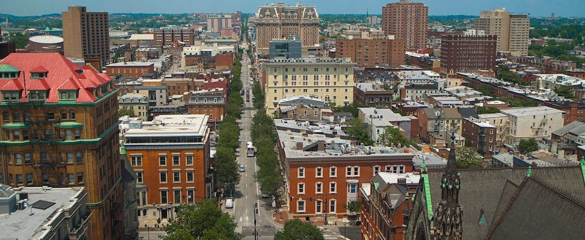
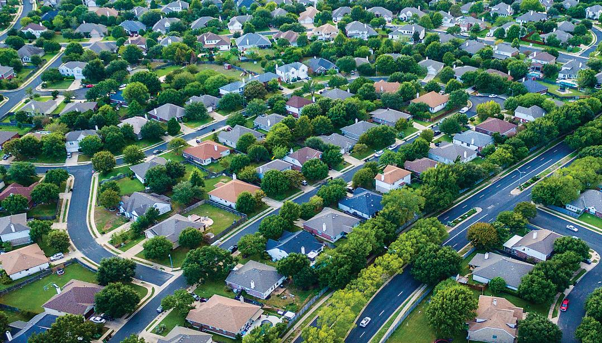
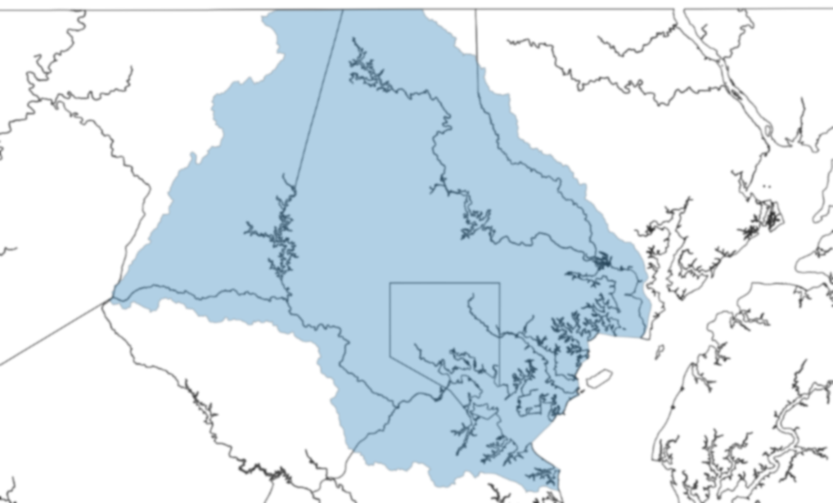
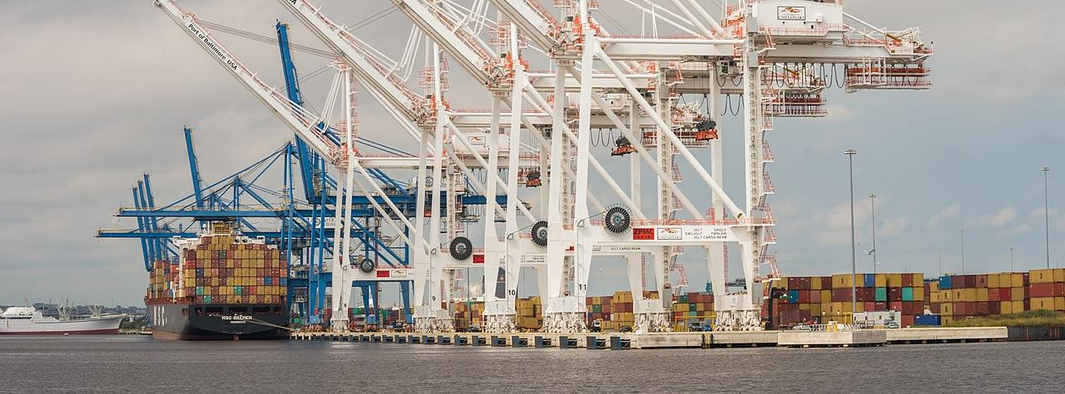
Openness: fairness

Slide 14

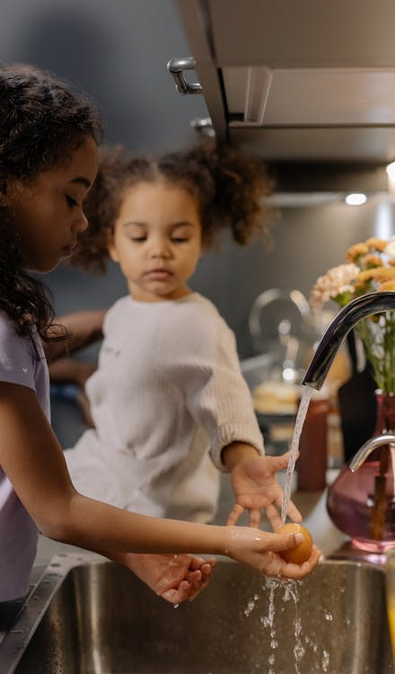
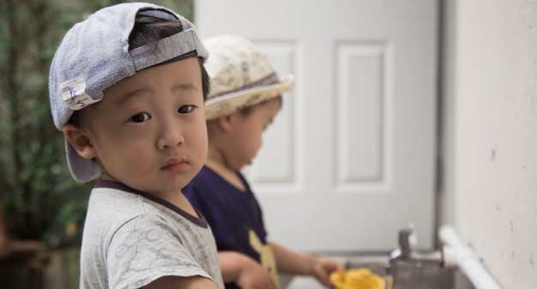
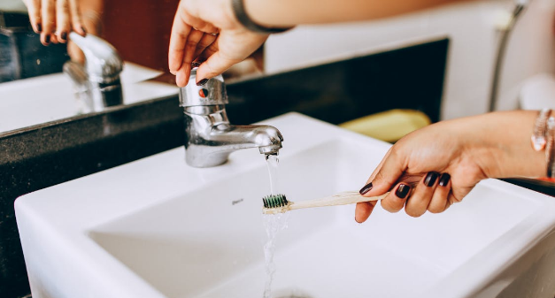

Everyone

Slide 15
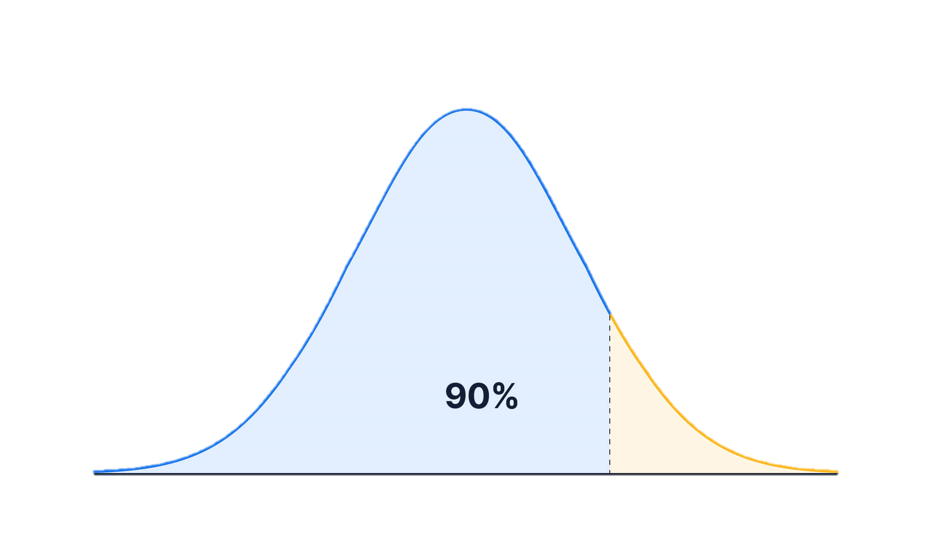
Justice is in the tails of the distribution

Slide 16
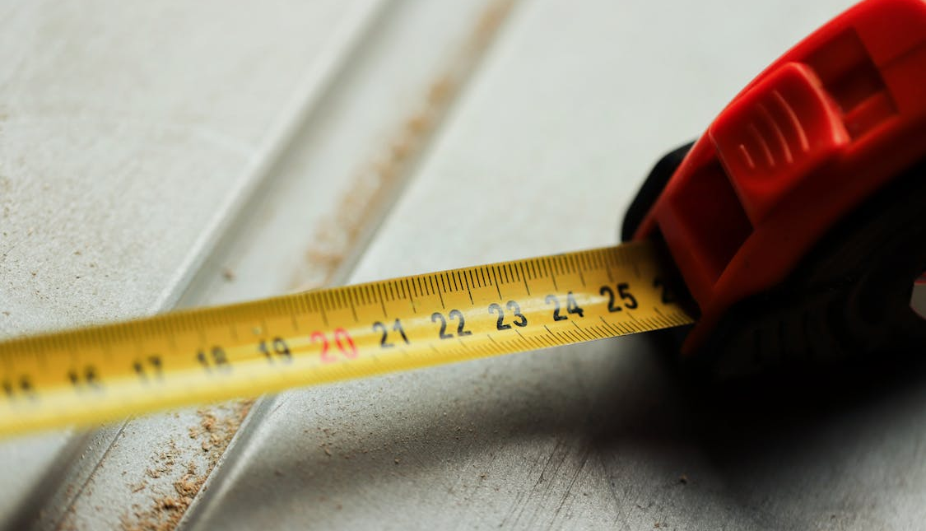
Measurement
If you want something to count, find a way to count it.

Slide 17
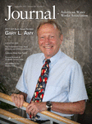
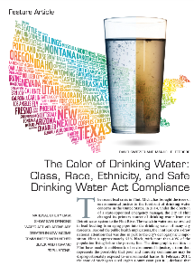
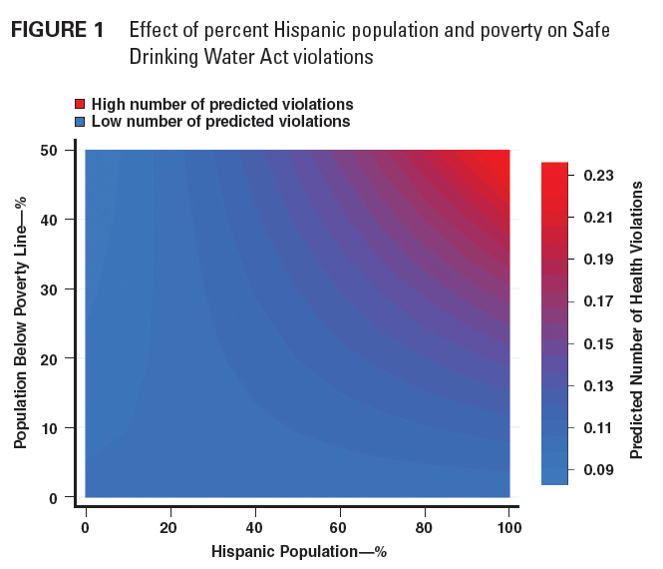
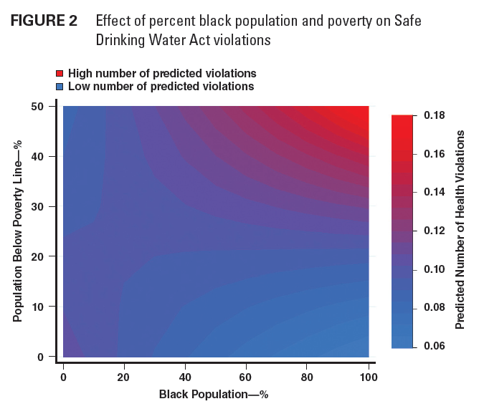
Drinking water & environmental justice
Switzer & Teodoro (2017)

Slide 18
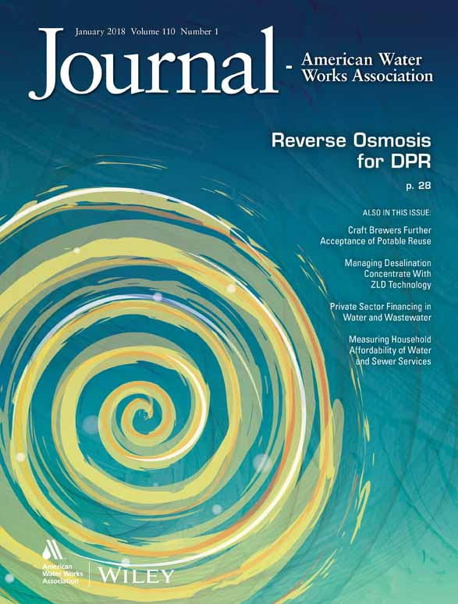
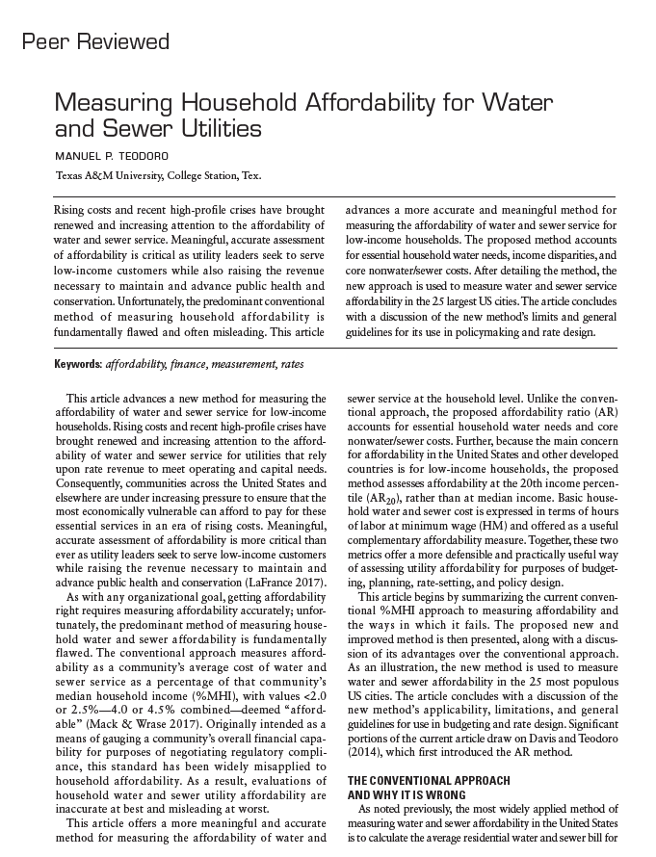
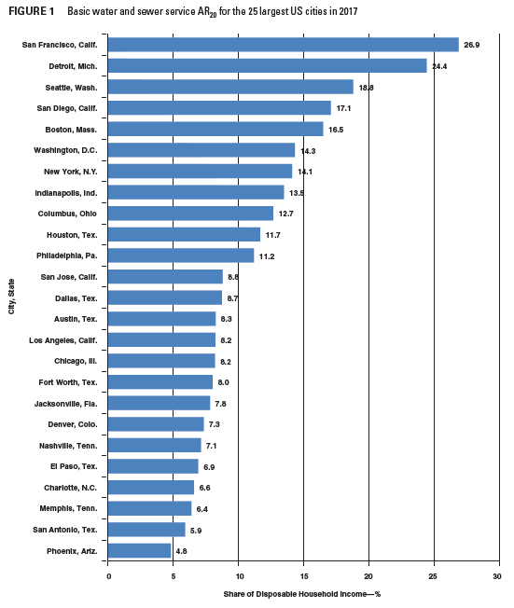
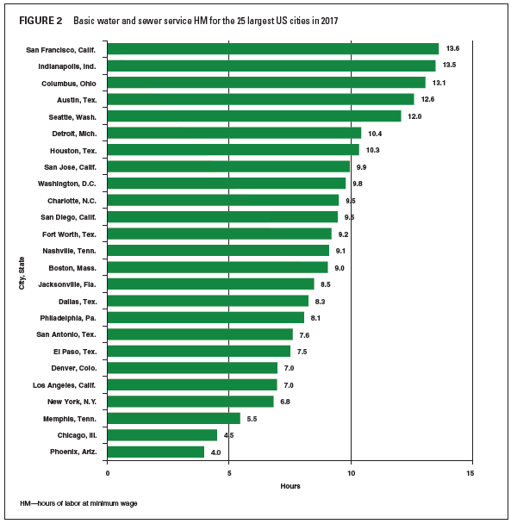
Household Affordability
Teodoro (2018)
AR₂₀
Hrs at minimum wage

Slide 19
Affordability Ratio (AR)
Price of Basic water & sewer as % discretionary income
(Price of basic per capita water + sewer service) x Household size
(Household income – non-water essential expenses)
Taxes, Housing, health care, food, home energy

Slide 20
Affordability Ratio (AR)
Price of Basic water & sewer as % discretionary income
(Price of basic per capita water + sewer service) x Household size
(Household income – non-water essential expenses)
Affordability Ratio, 20th income percentile
(AR20)

Slide 21
Hours at Minimum Wage (HM)
Basic water & sewer price in hours at minimum wage
(Price of basic per capita water + sewer service) x Household size
Hourly minimum wage

Slide 22
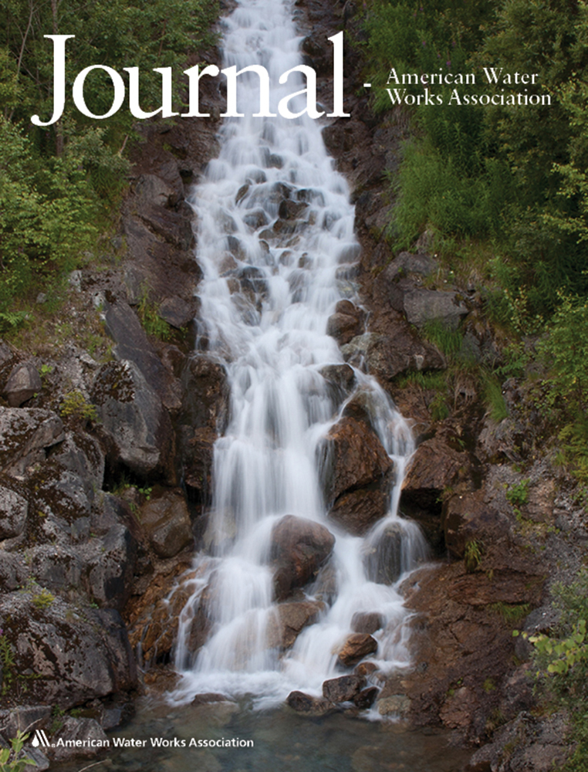
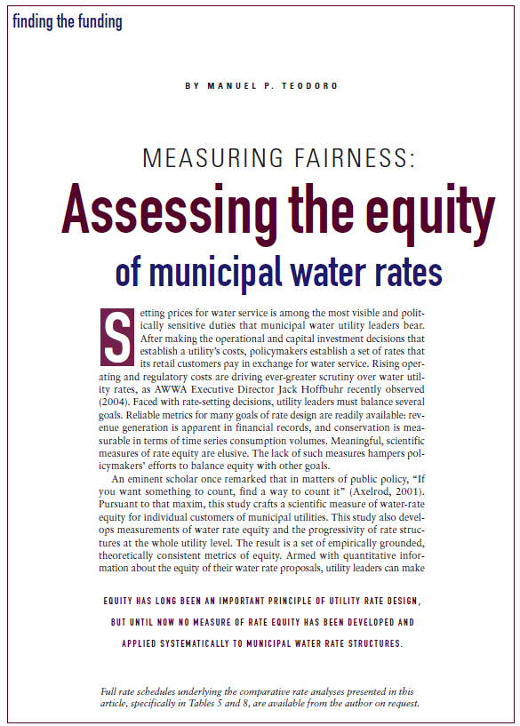


Cost of Service Equity
Teodoro (2005)

Slide 23

Cost of Service Equity
Teodoro (2005)

Slide 24

Quality / Level of Service Equity
Population Served: 1,000,000 residents
2022 Main Breaks:
1,600
Per 1,000: 1.6
Notes:
2022 Main Breaks: 1,600 overall- per 1,000: 1.6

Slide 25

Quality / Level of Service Equity
Population Served: 1,000,000 residents
2026 Main Breaks:
1,000
Per 1,000: 1.0
Notes:
2022 Main Breaks: 1,600 overall- per 1,000: 1.6

Slide 26


Quality / Level of Service Equity
Main Break Inequality by Block Group:
.33
Main Breaks Per 1,000
Notes:
2022 Main Breaks: 1,600 overall- per 1,000: 1.6

Slide 27

Quality / Level of Service Equity
Main Break Inequality by Block Group:
.54
Main Breaks Per 1,000
Notes:
2022 Main Breaks: 1,600 overall- per 1,000: 1.6

Slide 28
Hydrological citizenship
Everyone

Slide 29

Gunpowder-Patapsco Watershed
Population:
1.98 Million
Notes:
https://www.epa.gov/urbanwaterspartners/gunpowder-patapsco-watershed-map- EPA Urban Watershed-
Gunpowder-Patapsco Watershed
Total Population: 1979551

Slide 30

Gunpowder-Patapsco Watershed
Baltimore Share:
28.96%
Notes:
Baltimore Population:
573243
H Citizenship Percentage: 28.95823

Slide 31

Gunpowder-Patapsco Watershed
City/County Share:
71.94%
Notes:
City and County Population withing watershed: 1424039
City and county H citizenship percentage: 71.93747

Slide 32
Putting it all together
Equity
Excellence
Openness
…for Everyone

Slide 33

Drinking Water Governance Framework
Morales & Teodoro (2026)
Strong
Principle of Equality
Performative
Trust
Moral
Trust
Hydrologically-bounded citizenship

Slide 34

Equity
Excellence and openness for everyone.

Slide 35


Excellence and openness for everyone.
Manny Teodoro & David Switzer
Baltimore Regional Water Governance Model Workgroup
Meeting #3 | 20 May 2026

